Slide 1
Paying for College:
Financial Aid Tips and Free Application for Federal Student Aid (FAFSA) Information
Advisement and Counseling Services

Slide 2
Partners

Slide 3
Goals of the Workshop
Understand the types of Financial Aid to pay for college
Understand why the FAFSA is important
Understand tips and tools for successfully completing the FAFSA
Understand the role of the College Financial Aid Office

Slide 9
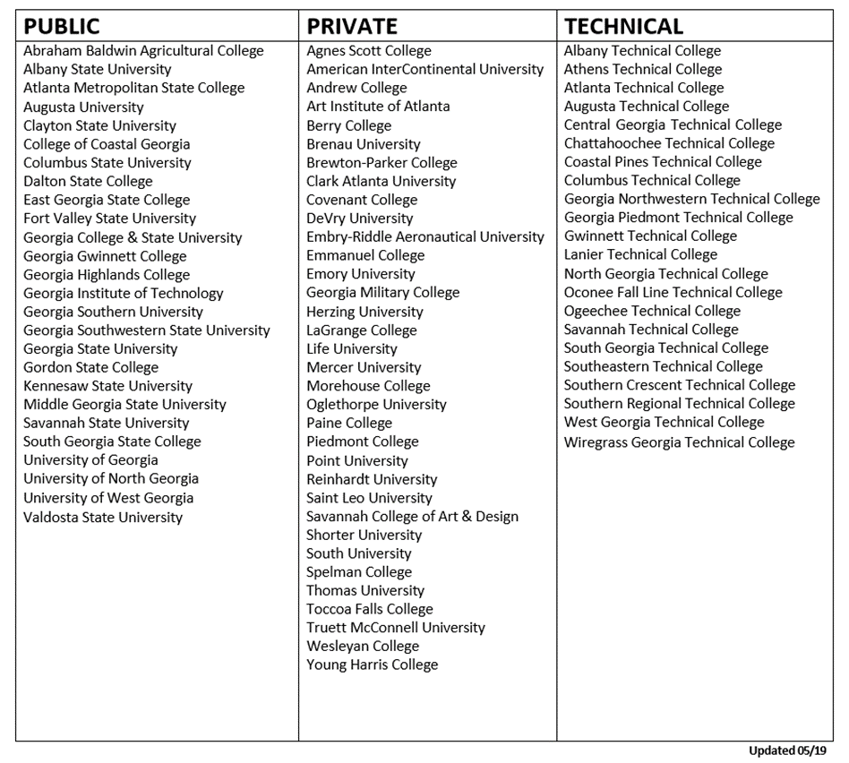
Eligible Institutions

Slide 23
College Financial Aid Advisors
How Does Financial Aid Work:
The Breakdown

Slide 24
One Step Closer to Graduation! Complete your FAFSA
Georgia State: Student Financial Management Center

Slide 25
Apply Today!
Completing the 22-23 FAFSA for Fall 2022 gets you one step closer to graduation and achieving your dreams!
You may gain access to First Come First Serve Awards
Completing early leaves more time to complete any additional paperwork
The application should take no more time than a job application or an episode of your favorite TV show
Fall Awarding had already begun!

Slide 26
Prepare
Social Security Card
Alien Registration Number for eligible non-citizens
2020 Federal Tax Returns (student and parent if applicable)
Records of untaxed income (child support received, interest income and veterans noneducational benefits
Records of assets (includes savings and checking account balances, investments such as stock and bonds and real estate)
Notes:
In order to receive Federal financial aid, students must complete the Free Application for Federal Student Aid (FAFSA). The correct website to complete the FAFSA is www.fafsa.gov. The most important feature in this acronym is FREE!!! Students should never pay any individual or organization to complete their FAFSA. The following items are needed when completing the FAFSA:

Slide 27
FSA ID
Your FSA ID acts as both an electronic signature and gives you access to all your federal student aid accounts
Students also need an FSA ID
Go to: https://fsaid.ed.gov
If you are a Dependent student your parent will also need to apply for an FSA ID
Notes:
Prior to completing the FAFSA both students and parents of dependent students will need to create a FSA ID. Creating a FSA ID can be achieved by visiting https://fsaid.ed.gov. The FSA ID is used to confirm student/and or parent identity when accessing financial aid information as well as serving as a legal online signature for the FAFSA and other federal student aid documents. DO NOT use nicknames on the FAFSA. Students and parents should store their FSA ID in a secure place and NEVER reveal it to other individuals.
If this is not your first time filling out the FAFSA form, you may need to wait one to three days for us to verify your info before you can use your FSA ID to renew your FAFSA form and sign it online. Parent: If your child is required to report parent information on the FAFSA form, you need to create your own FSA ID in order to sign your child’s FAFSA form online.

Slide 28
Start the FAFSA

Slide 29
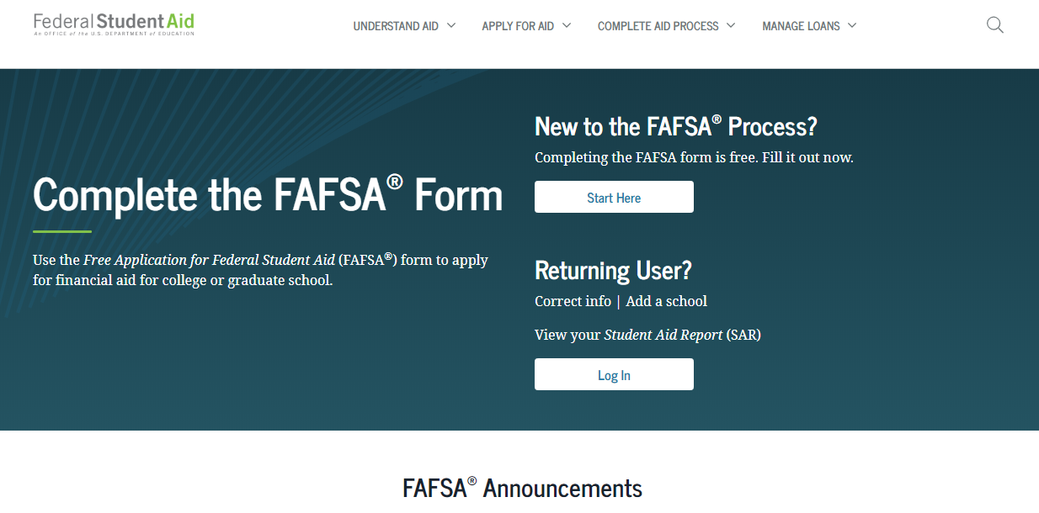

Slide 30
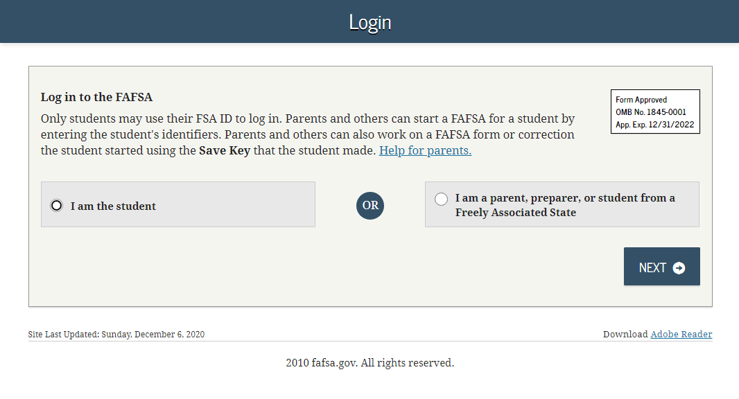
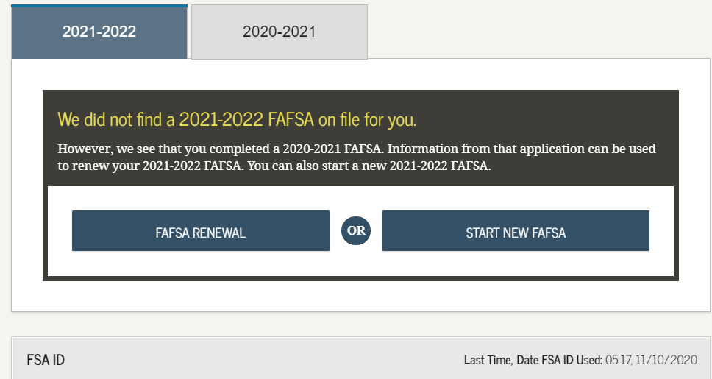
Logging in
Notes:
Transition 1: Choose the option that best applies to you. If you are the student: Click “I am the student.” Enter your FSA ID username and password, and click “Next. "If you are the parent: Click “I am a parent, preparer, or student from a Freely Associated State.”
Transition 2: If you submitted a 2019-2020 FAFSA, select ”FAFSA Renewal" for the information from that application to be used to renew your 2020-2021 FAFSA. If you didn't submit a 2019-2020 FAFSA, select "Start New FAFSA."

Slide 31
Built in Assistance
Notes:
1) Students can receive help in completing their FAFSA by contacting the Federal Student Aid Information Center at 1-800-433-3243.
2) The FAFSA consists of eight sections that must be completed.
3) It should take a least an hour to complete the FAFSA depending a student’s answers and whether they have all the necessary information
4) Students do not have to complete the FAFSA in one session. The application can be saved for up to 45 days.
5) Refer to slide #2
6) At the end of the completing the FAFSA, students and parents, if applicable must agree to the FAFSA certification statement and sign the application. The easiest way to sign the FAFSA electronically is through the FSA ID.
7) The Department of Education is committed to protecting the privacy of all personal information entered into this database.

Slide 32
Demographic Info

Slide 33
Pick Georgia State
School Code: 001574

Slide 34
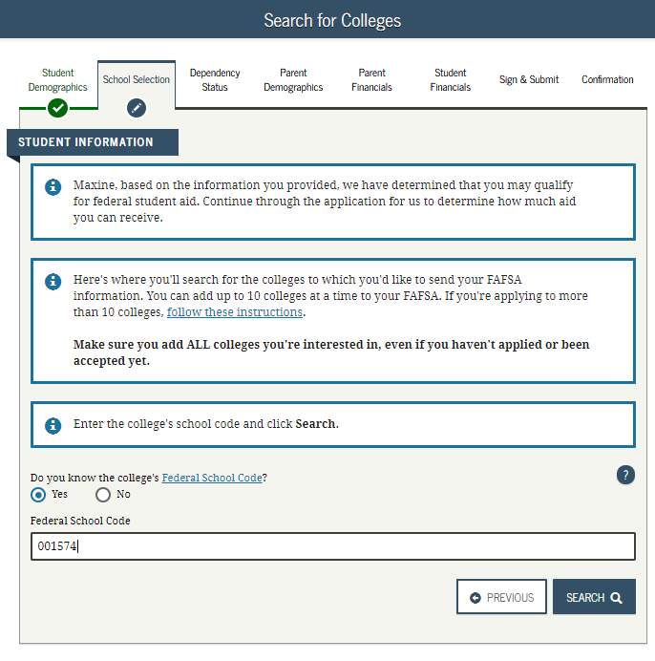
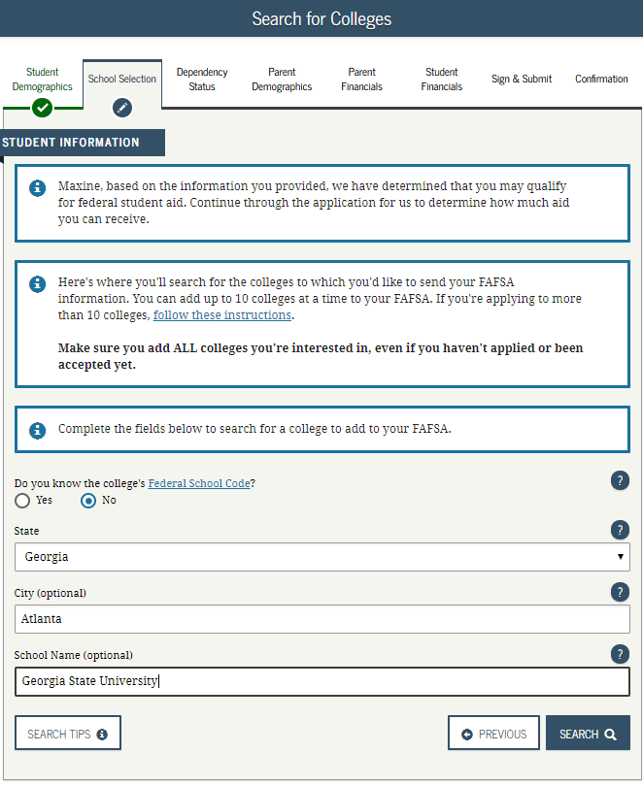
School Selection
Notes:
Transition 1: If you know the college’s Federal School Code, you can choose “Yes” and enter the code on this page. If you do not know your intended college’s Federal School Code, enter the city, state, and name of the college. You may select up to ten schools that you're interested in attending.
Transition 2: Select the correct school from the search results by clicking the checkbox on the left.

Slide 35
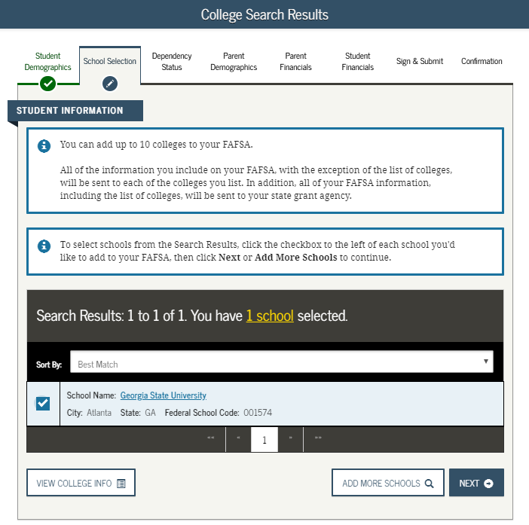
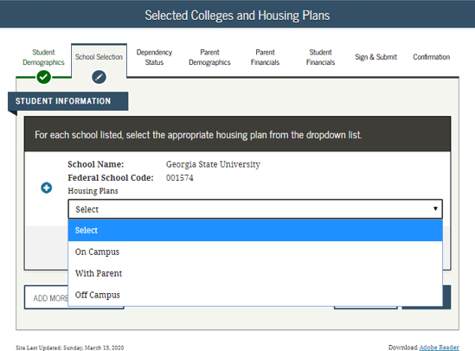
School Selection
Notes:
Transition 1: If you know the college’s Federal School Code, you can choose “Yes” and enter the code on this page. If you do not know your intended college’s Federal School Code, enter the city, state, and name of the college. You may select up to ten schools that you're interested in attending.
Transition 2: Select the correct school from the search results by clicking the checkbox on the left.

Slide 36
Dependency Status
Household and Parental Information

Slide 37
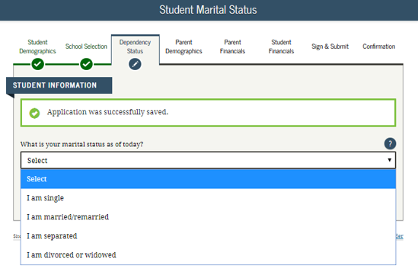
Household Information
Notes:
Transition 1: Indicate your marital status as of the date in which you are completing your FAFSA.
Transition 2: Select "Yes" if you have children, or are expecting children in the year for which you are applying for aid. Select "No" if not.
Select "Yes" if you have a dependent (someone who may not be your own child, or possibly even a parent), AND you also provide more than 50% of their living expenses. Select "No" if not.

Slide 38
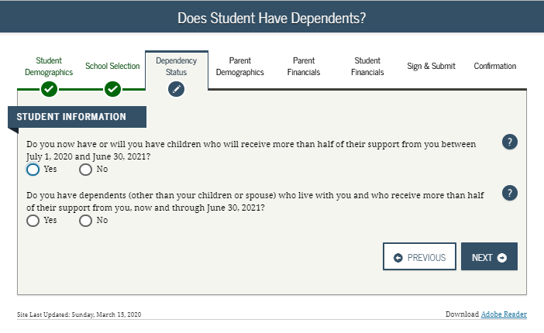
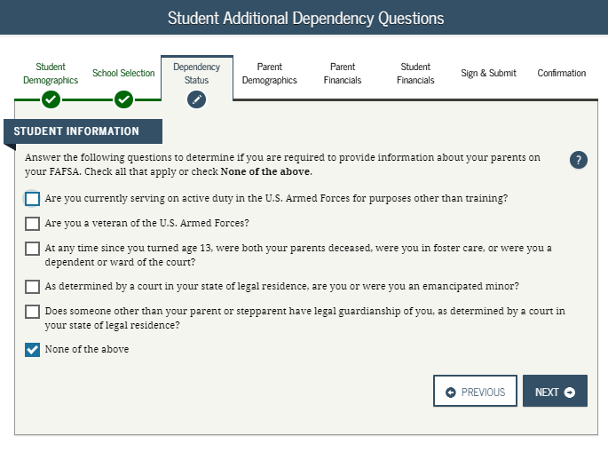
Household Information
Notes:
Transition 1: Indicate your marital status as of the date in which you are completing your FAFSA.
Transition 2: Select "Yes" if you have children, or are expecting children in the year for which you are applying for aid. Select "No" if not.
Select "Yes" if you have a dependent (someone who may not be your own child, or possibly even a parent), AND you also provide more than 50% of their living expenses. Select "No" if not.

Slide 39
Parental Information

Slide 40
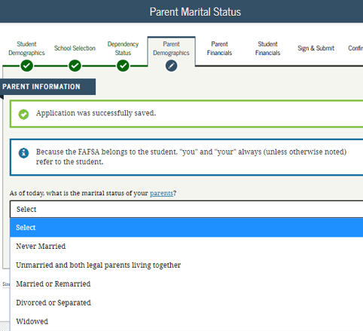
You might need a parent for this part…

Slide 41
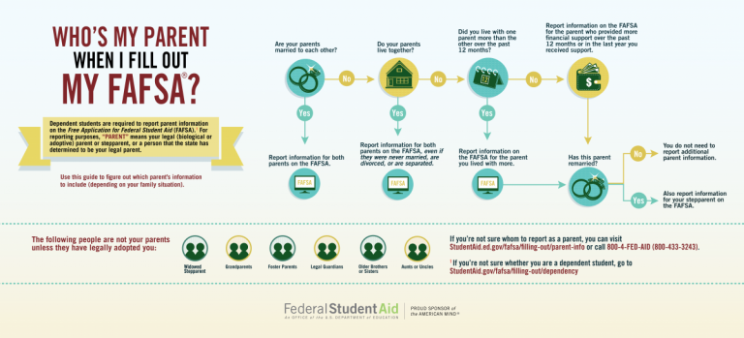
Notes:
This is where your parent(s) will provide basic demographic information. If your parents have remarried, they must enter they are married on the FAFSA. Most students mistakenly report their parent as single or divorced when a parent is no longer with a biological parent. A most common error is that it doesn’t matter if you don’t live with your parent(s); you still must report information about them if you were determined to be a dependent student.

Slide 42
Financial Information or….Taxes, taxes, taxes

Slide 43
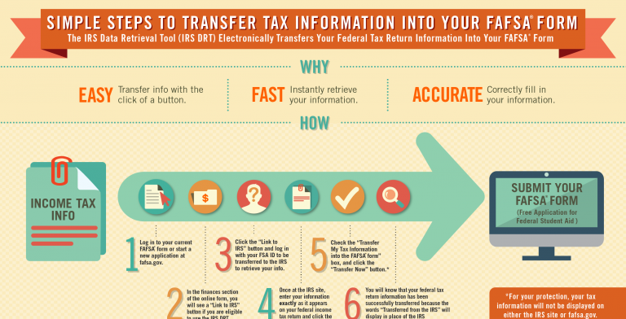
Notes:
Here is where you and your parent(s) (if applicable) will provide your financial information. If your parents are married or remarried, make sure to enter financial information for both parents. This is a common error in which many students neglect to enter their step-parent’s income which may cause delays in awarding financial aid by a student’s college.

Slide 44
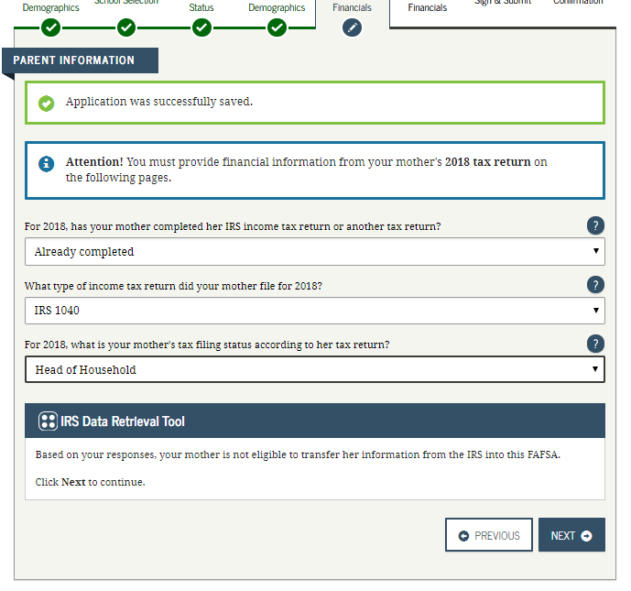
Parent Taxes
Notes:
This step is incredibly simple if you use the IRS Data Retrieval Tool (DRT). The IRS DRT allows you to import your IRS tax information into the FAFSA form with just a few clicks. Using this tool also may reduce the amount of paperwork you need to provide to your school. So if you’re eligible, use it!

Slide 45
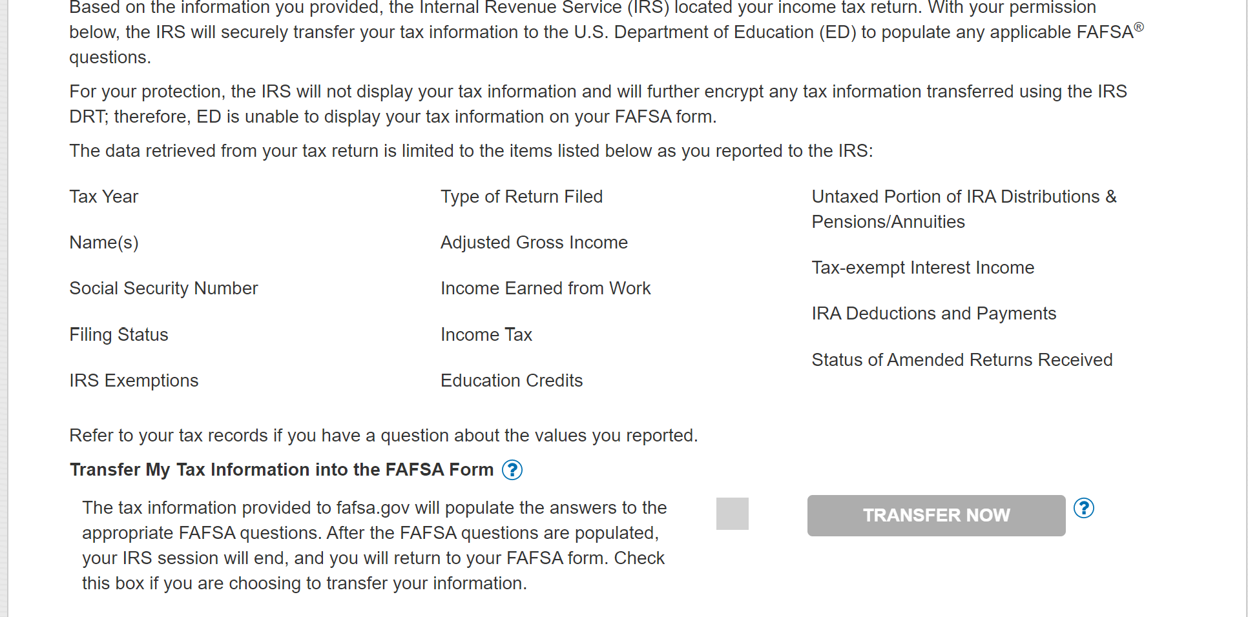
Notes:
If you entered the correct information to retrieve your income information, this screen will appear. It is extremely important that you choose “TRANSFER NOW” as this will prevent many errors that may haver to be verified by your college.

Slide 46
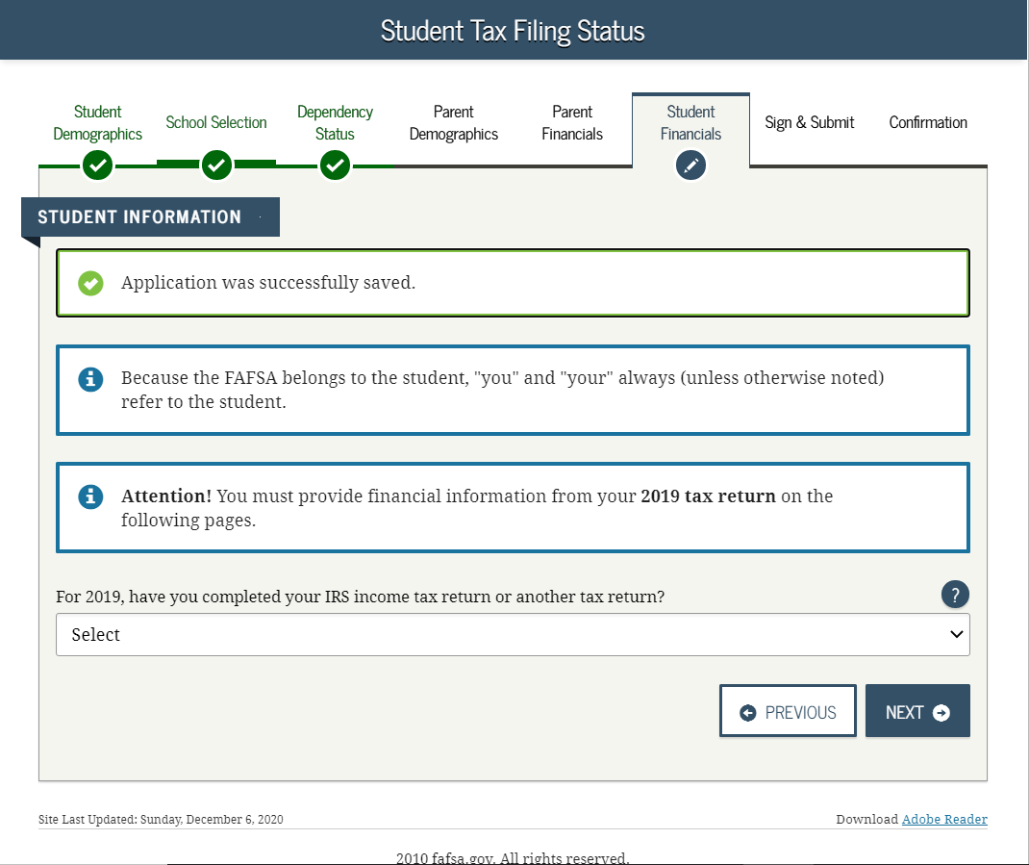
Your Taxes

Slide 47
Almost Done
Sign and Submit

Slide 48
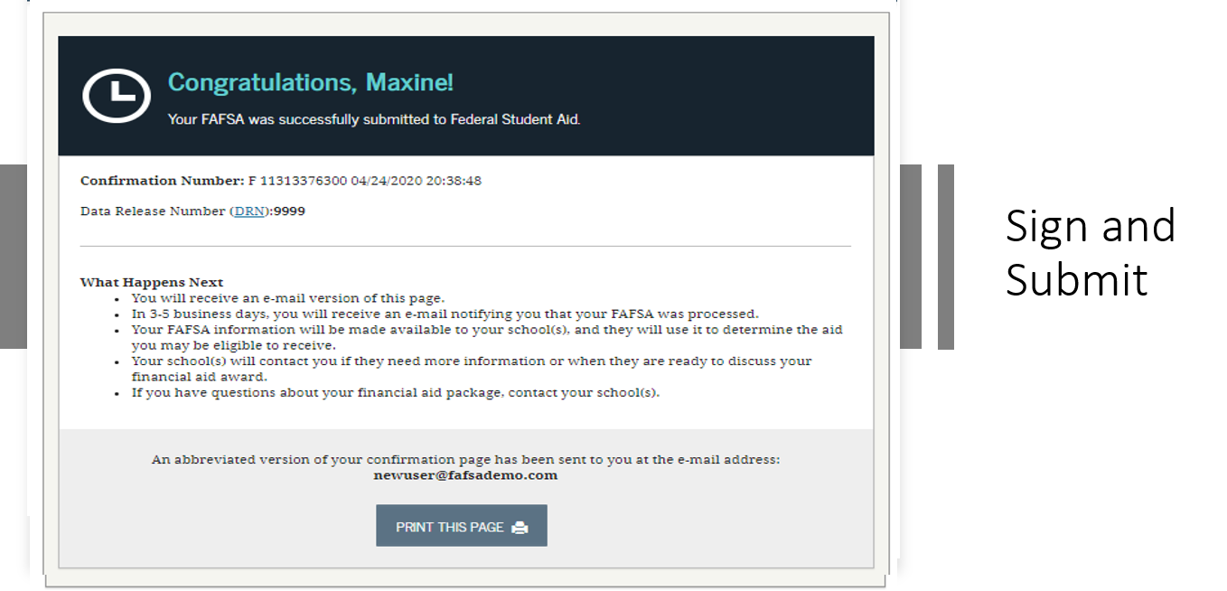

Slide 49
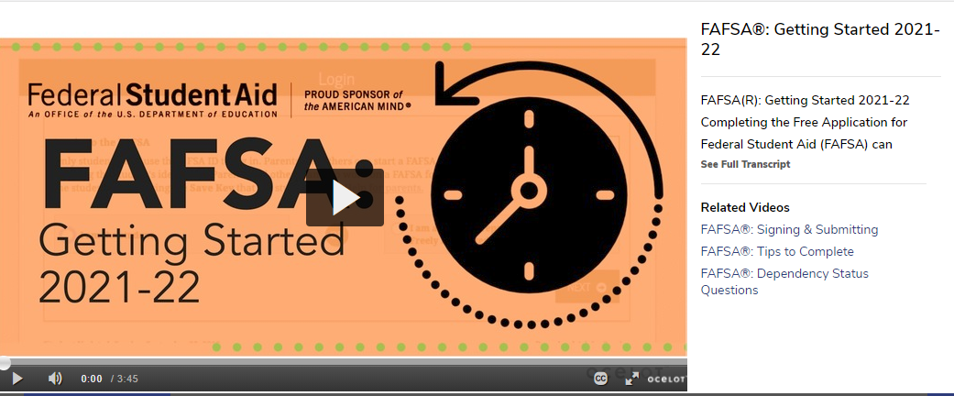
We’ve got you!
Georgia State’s Online Video Resources:
Gsu.financialaidtv.com
Student Financial Services New Student Guided Path:
https://sfs.gsu.edu/new-students/
Notes:
Georgia State also have a video library that reviews all sections of the FAFSA and many of the common questions we receive.
Speak to things to avoid:
Leaving blank fields: Too many blanks may cause rejected applications. Enter a “0” wherever possible instead of leaving a blank
Listing an incorrect social security number: Double check and triple check this entry to ensure accuracy
Failing to use your legal name: Enter the name that is listed on your social security card. Do not enter nicknames
Listing the Adjusted Gross Income (AGI) as the total wages earned. The AGI and total wages earned are not the same
Incorrectly filing income taxes as head of household when married and residing in the same home
Listing student marital status incorrectly. Indicate your marital status as of on the day you complete your FAFSA
Listing parent marital status incorrectly. If your custodial parent remarried, your step parent’s information must be included. You must also report your step parent’s financial information.
Failing to submit your FAFSA after providing your FSA ID. The college of your choice will never receive your FAFSA until it has been submitted with the student’s and or parent’s electronic signature
Not completing the FAFSA form by the deadline: Each college may sets their own deadlines in order to offer institutional funds. Apply early. The FAFSA form opens up on October 1st.
Not using the IRS Data Retrieval tool to transfer information from the IRS unto the FAFSA: Using the IRS Data Retrieval tool allows financial information to be entered correctly unto the FAFSA
Confusing parent information with student information: Many parents complete the FAFSA for the student but they must remember the FAFSA form is the student’s application.

Slide 50
Keep Looking Ahead!
FAFSA opens October 1st every year for the NEXT award year. Keep applying early until to get to toss your cap!
If you need help! Submit a Panther Answer Ticket using the Icon below on paws.gsu.edu

Slide 51
Questions

Slide 52
Resources for Students:
Student Financial Services Guided Path for New Students:
https://sfs.gsu.edu/new-students/
Who is my parent on the FAFSA?
https://studentaid.gov/sites/default/files/who-is-my-parent.png
Simple steps to transfer tax information:
https://studentaid.gov/sites/default/files/transfer-tax-info-to-fafsa.png
GSU 20-21 FAFSA Playlist:
https://gsu.financialaidtv.com/play/46163-2020-2021-fafsa-tutorial/63536-fafsa-getting-started-2020-21

Slide 53
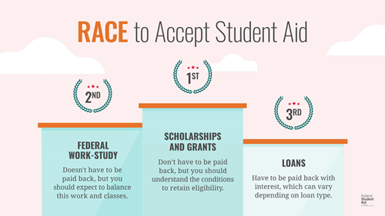
Financial Aid Definitions
What is Financial Aid?
Types of Financial Aid
Grants
Scholarships
Work-Study Jobs
Loans

Slide 54
Why Complete the FAFSA?
Myth vs Reality
The Free Application for Federal Student Aid (FAFSA) opens October 1st each year. Visit https://studentaid.gov/h/apply-for-aid/fafsa or download the myStudentAid app in your app store on a mobile device.
The federal deadline to submit the FAFSA each year is June 30th.
Most Common Myth
“My parents make too much money, so I won’t qualify for any aid.”
FACT: The reality is there’s no income cut-off to qualify for federal student aid. It doesn’t matter if you have a low or high income. Most people qualify for some type of financial aid. Many factors besides income—such as your family size and your year in school—are considered to determine your aid eligibility.
Notes:
Cecilia Personal Testimony may work here…..
·Once your FAFSA has been submitted, allow 3-5 days for the Department of Education to approve your application.
·You will be notified through the email address you list on your FAFSA.
·Look over your Student Aid Report (SAR) which will be provided to you via email within 3-5 days by the Dept of Education. It will also be available in your account on Studentaid.gov. This report will provide your Expected Family Contribution number or EFC and give you a summary of what you qualify for!
·Once GSU receives your FAFSA, we will contact you if anything else is needed. As always, monitor your paws account for updates regarding your financial aid award package.

Slide 55
FAFSA Eligibility Requirements
You must meet certain requirements to qualify for federal student aid
Basic Eligibility Criteria
Demonstrate financial need (for most programs)
Be a U.S. citizen or an eligible noncitizen
Have a valid Social Security number
Be enrolled or accepted for enrollment as a regular student in an eligible degree or certificate program
Find more information at https://studentaid.gov/understand-aid/eligibility

Slide 57
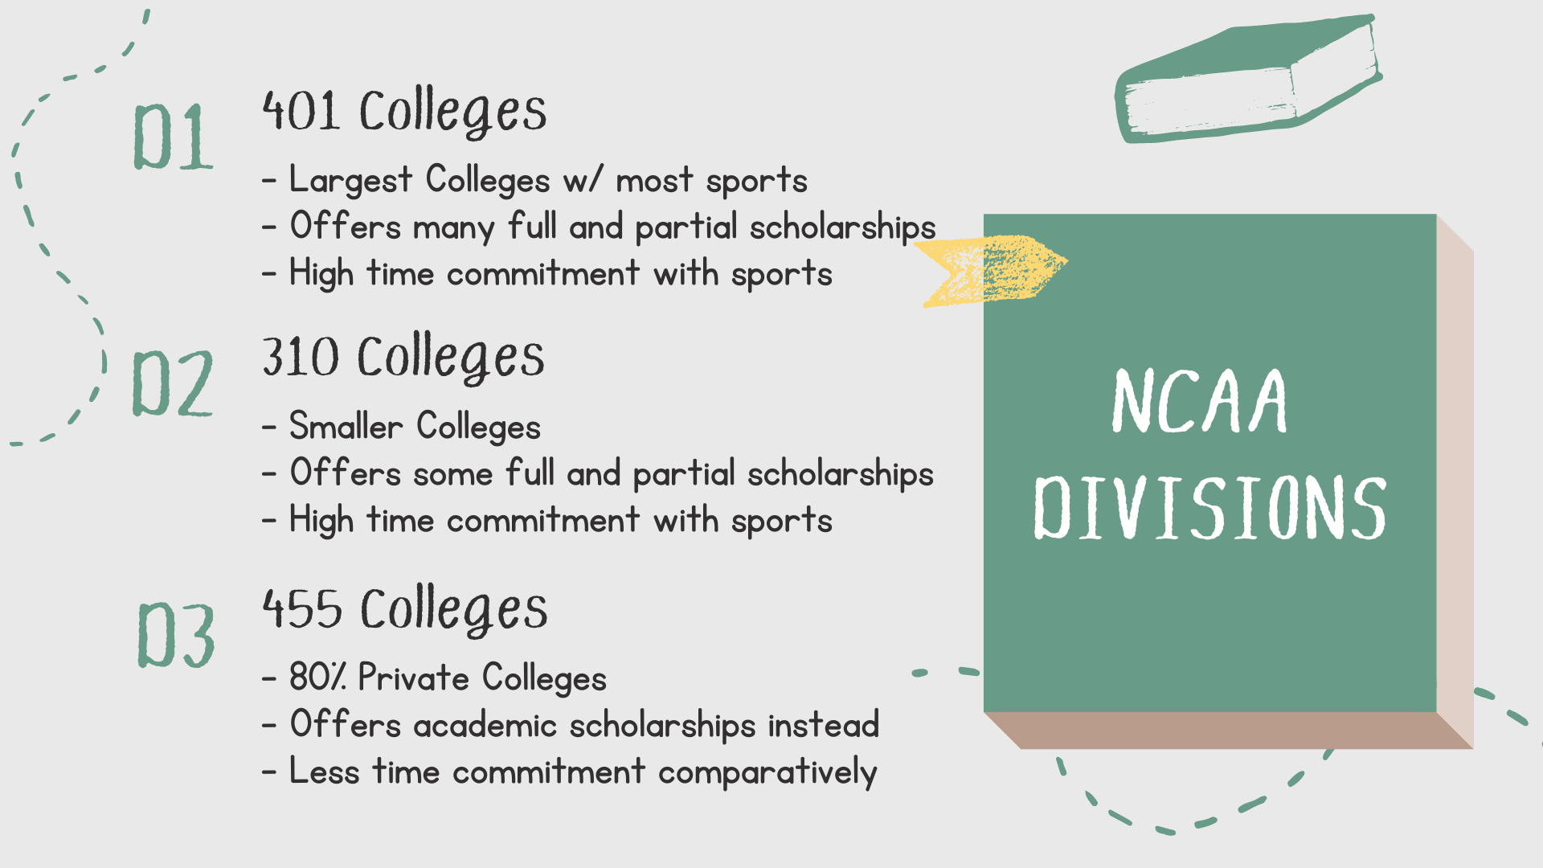

Slide 59
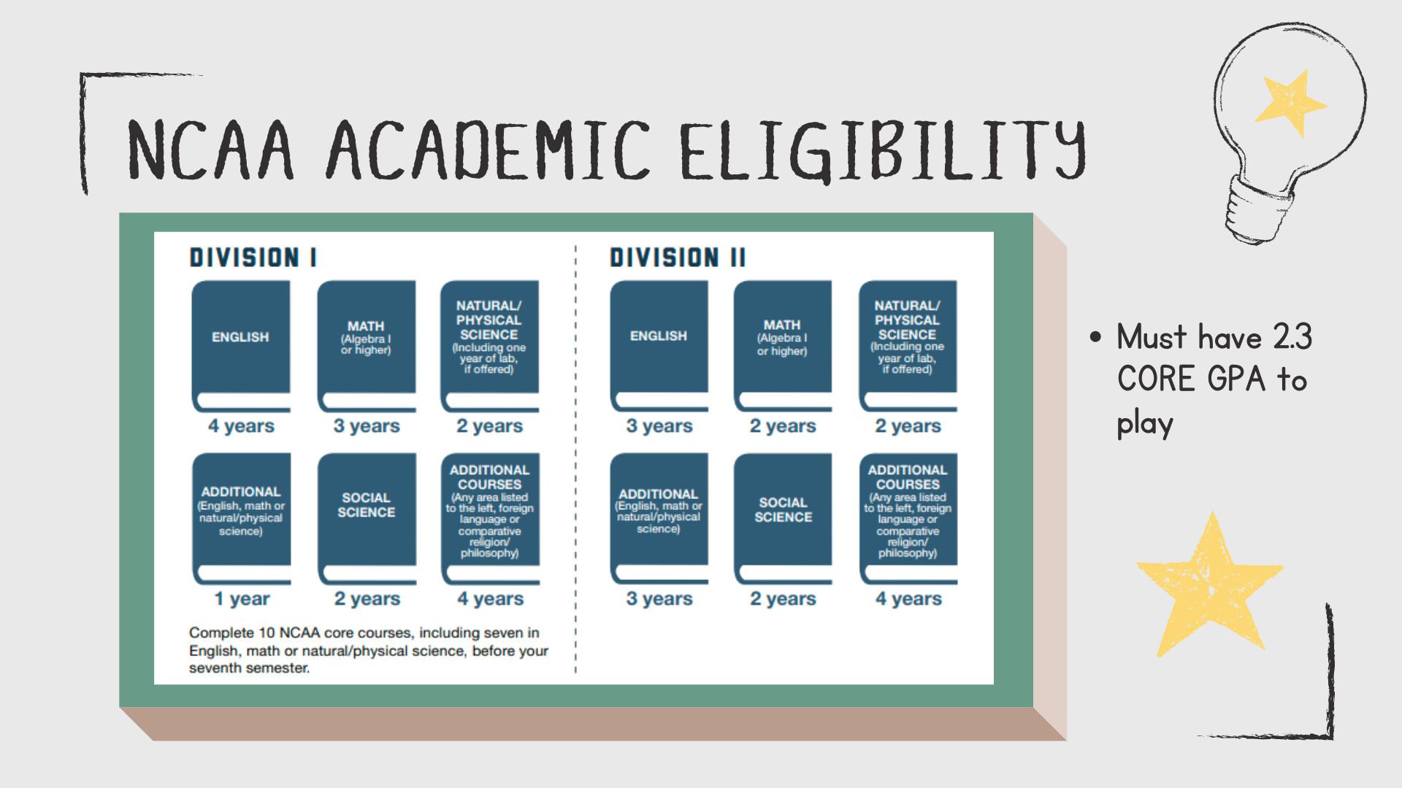

Slide 60
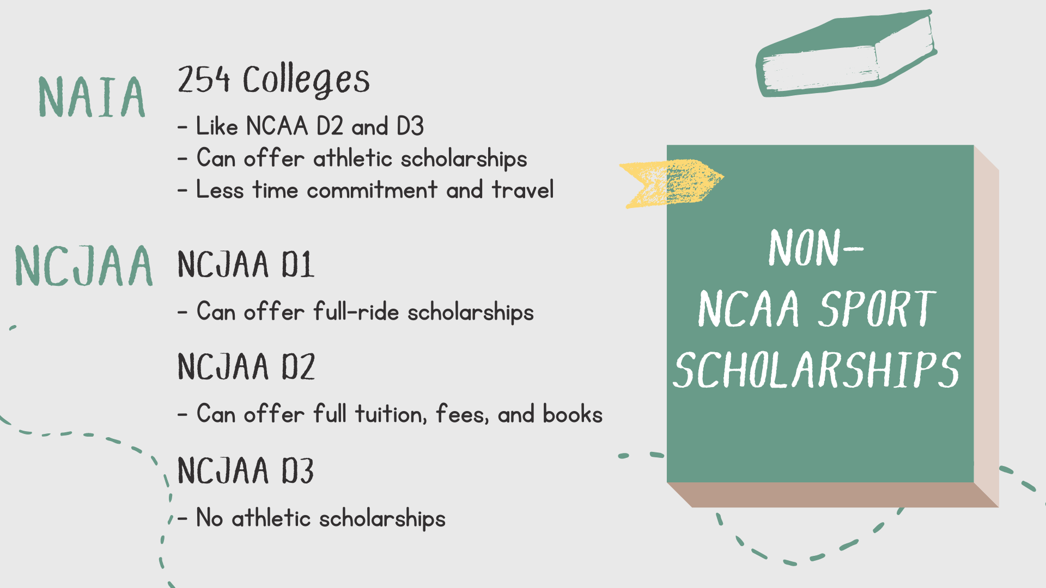

Slide 61
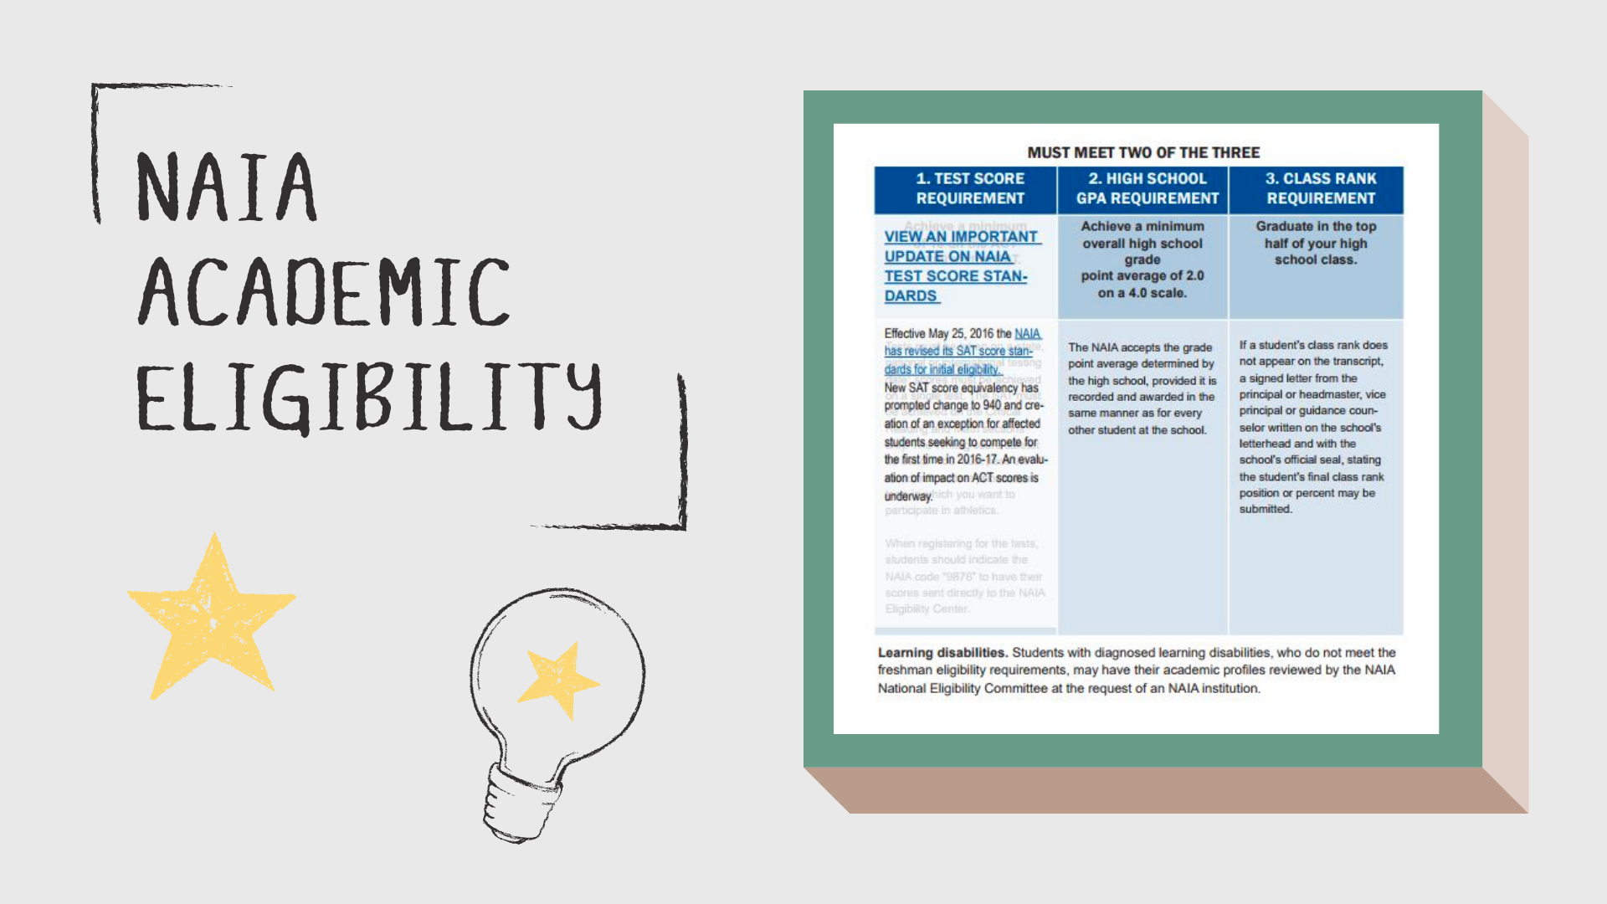

Slide 62
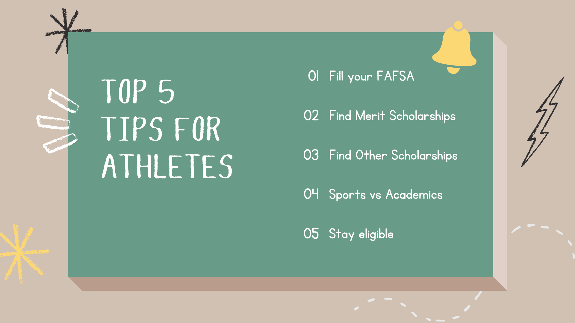

Slide 65
Additional Resources
How Financial Aid Works
22-23 FAFSA Preview Presentation

Slide 66
Financial Aid/Scholarship Website:
https://schoolwires.henry.k12.ga.us/Page/93116
Thank you!!

